Slide 1




Stock Market Analysis
Team - 6
Soumya Rajadhyaksha 19BAI10120
Akshra Singh 19BCE10295
Manglam Tripathi 19BAI10118
Tarit Jaiswal 19BAI10153
Abhishek Patnigere 19BAI10092

Slide 2


What is Stock Market?
  A stock market or equity market is a market for the trading of company stock (shares) and derivatives at an agreed price.
  Shares (in stocks) represent a fraction of ownership in a business. The common feature of all these is equity participation. Different classes of shares have different voting rights.
  Ownership of shares is documented by a legal document that specifies the number of shares owned by the shareholder, and other specifics of the shares, such as the par value or the class of the shares (if any).

Slide 3

Who is a shareholder?
  A shareholder (or stockholder) is an individual or company (including a corporation) that legally owns one or more shares of a company.
  Shareholders are granted privileges depending on the class of stock, including the right to vote on matters such as elections to the board of directors, the right to share in distributions of the company's income, the right to purchase new shares issued by the company, and the right to a company's assets during liquidation of the company.
  Shareholders vary from individual stock investors to large hedge fund traders.
b.

Slide 4


How do we analyze stock market?
  Share market analysis is about using real data to evaluate a stock's value. The method uses revenues, earnings, future growth, return on equity, profit margins and other data to determine a company's underlying value and potential for future growth.
  A fundamental analyst would most definitely look at the balance sheet, the profit and loss statement, financial ratios and other data that could be used to predict the future of a company.
  The method uses revenues, earnings, future growth, return on equity, profit margins and other data to determine a company's underlying value and potential for future growth.

Slide 5
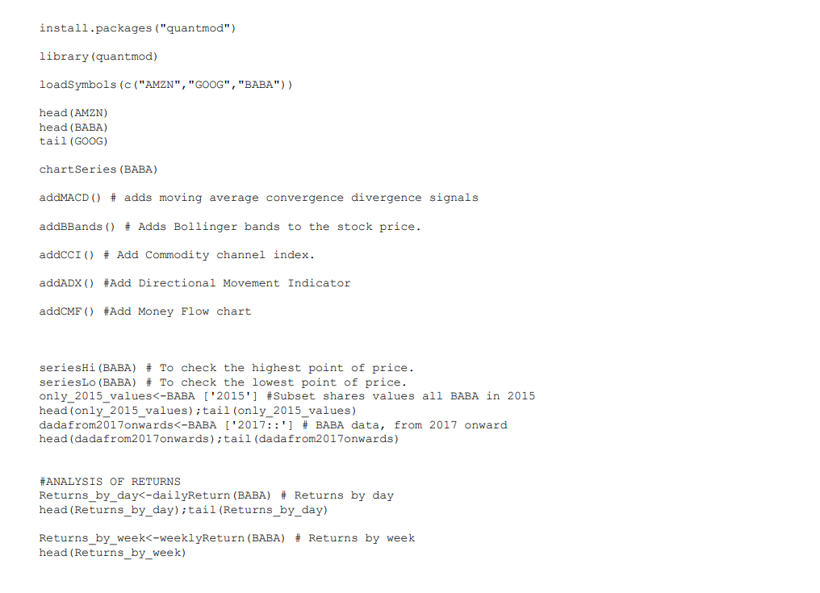
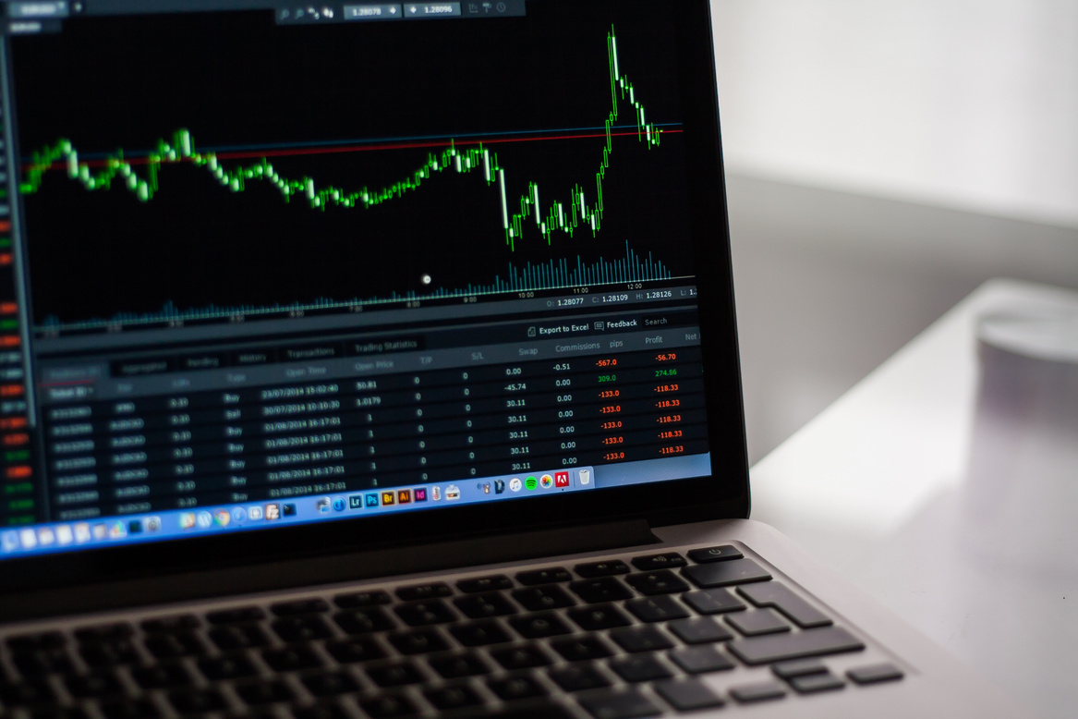
Analyzing stock in R

Slide 6
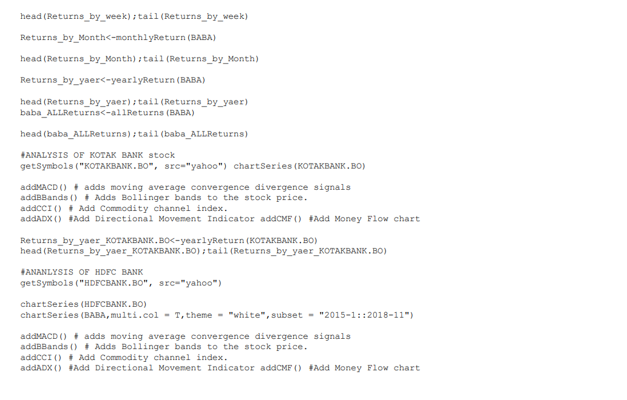

Slide 7
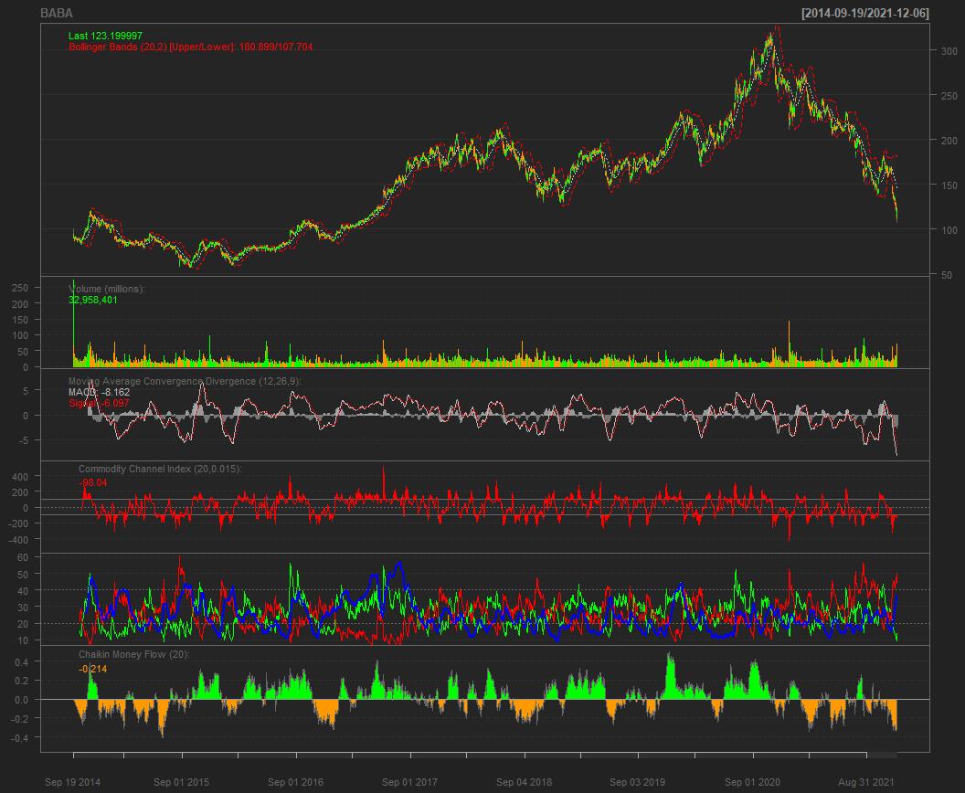

Slide 8


DEMO

